Slide 1
Tourist excursion route "Yenisei Ring"

Slide 2
"Yenisei Ring" - is a branded tourist route running through the territory of the Krasnoyarsk Territory, the Republics of Khakassia and Tyva, consisting of 3 modules:
Module 1
"Krasnoyarsk Zamanye"
Module 3
"Mysteries of Khakassia"
Module 2
"Pearls of Tyva"
The uniqueness of the route is that you can join any of the programme modules, or you can complete the whole itinerary!

Slide 3
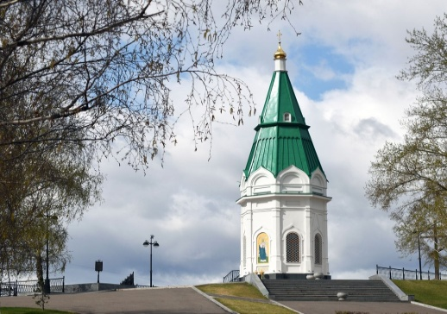
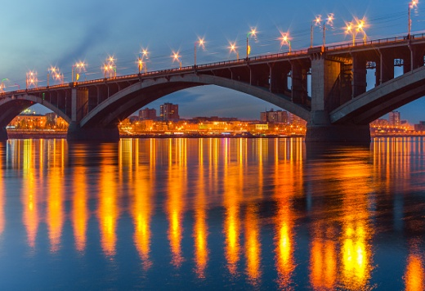
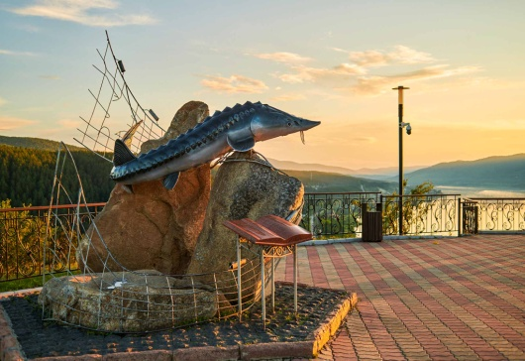
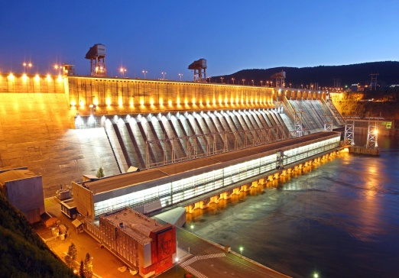
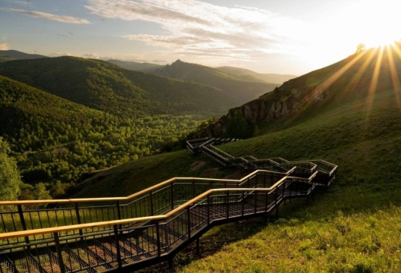
Krasnoyarskoye Zamanye
(1 module)
1 day - Krasnoyarsk
The highest flag of Russia
Holy Assumption Monastery
Paraskeva Pyatnitsa Chapel
Mira Avenue and Mira Square (the center of Krasnoyarsk)
Tsar Fish viewing platform
Divnogorsk quay
Hydroelectric power station (Krasnoyarsk Hydroelectric Power Station)
Torgashinskaya staircase (the longest staircase in Russia)

Slide 4
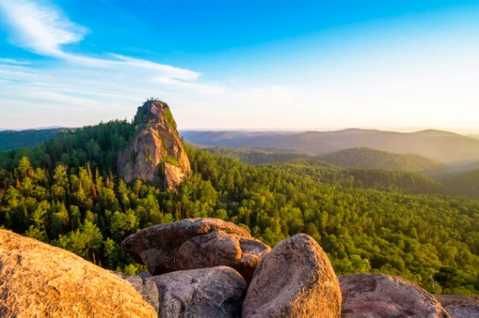
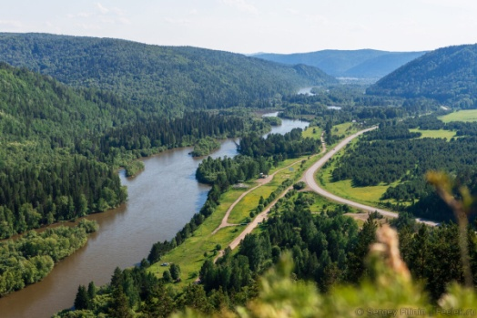
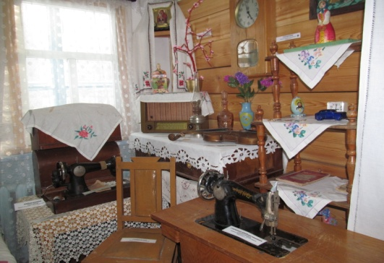
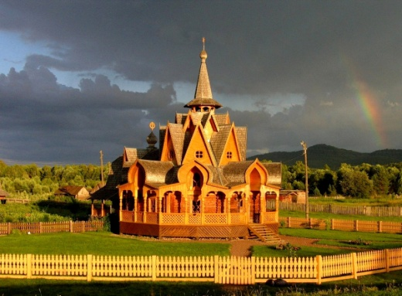
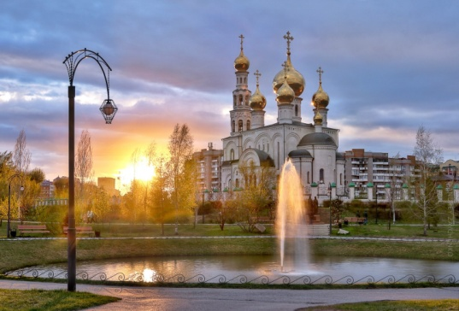
Krasnoyarsk Zamanye
(1 module)
Day 2
Krasnoyarsk - Mansky district
Stolby National Park
Narva (filming locations of the film "The Master of Taiga" with V.S.Vysotsky)
Stepnoi Bajey ("Partisan Republic")
Day 3
Mansky district - Abakan
Road through Sayan Mountains
City of the Sun (Vissarion community)
Abakan

Slide 5
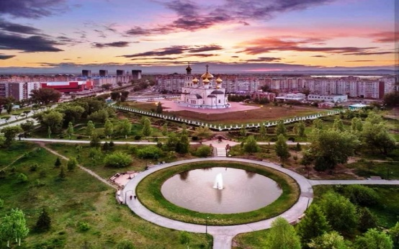
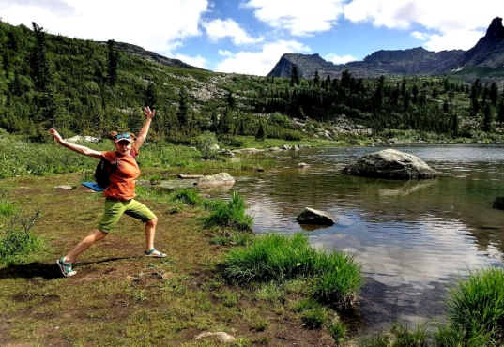
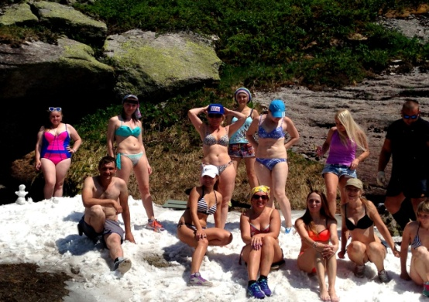
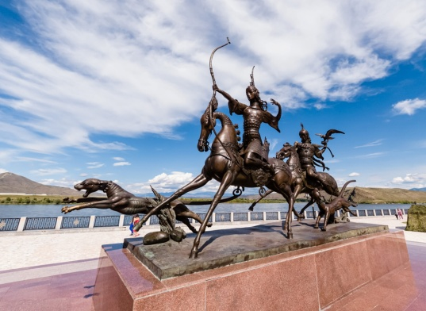
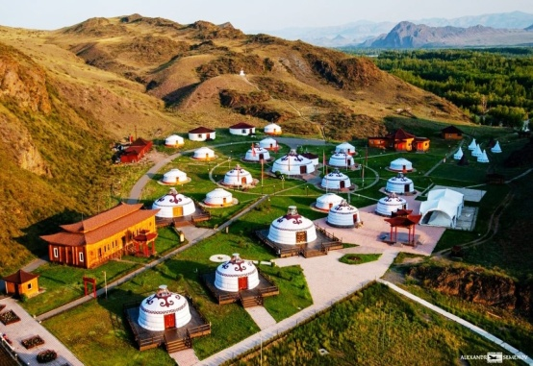
Pearls of Tyva
(2 module)
Day 4
Khakassia - Shushenskoye - Yergaki
Abakan - the capital of Khakassia
Shushenskoye - Lenin Museum
Yergaki Nature Park
Day 5
Yergaki – Kyzyl
Kyzyl - the capital of Tuva
Asia Centre
The largest Buddhist monastery in Russia "Tubten Shedrub Ling“
Scythian gold
Yurt complex "Aldyn Bulag“
Day 6
Republic of Tyva
Lake Svatikovo ("dead sea in the centre of Asia")
Durgensky canyon

Slide 6
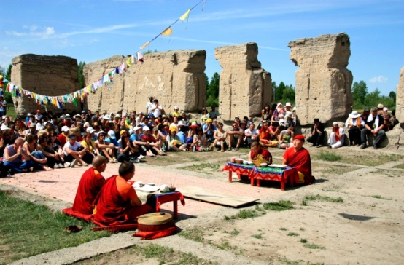
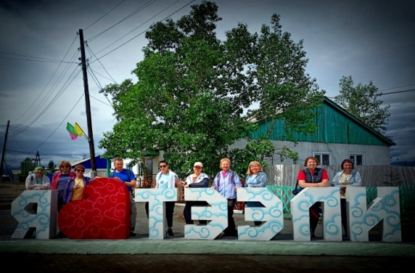
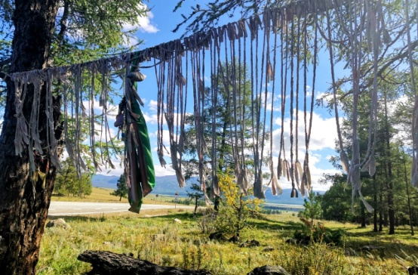
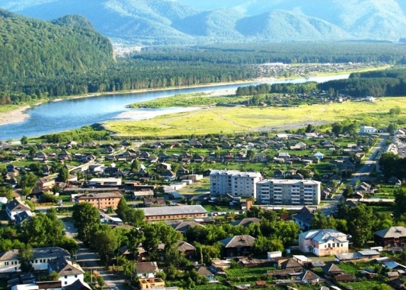
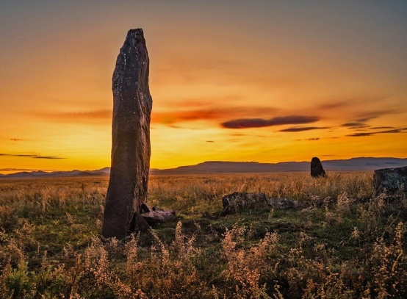
Pearls of Tyva
(2 module)
Day 7
Western Tyva
Golden Sands of Iime desert
Ustuu-Khuree Monastery
Teeli
Day 8
Sayan pass
Bai-Taiginsky kojun
100 (Sayan) pass
Abaza
Day 9
Southern Khakassia
Ancient stone Menhirs
Abakan

Slide 7
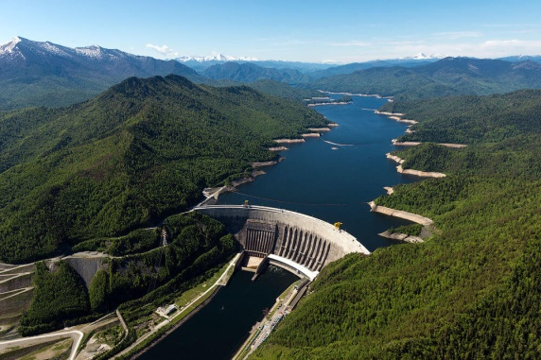
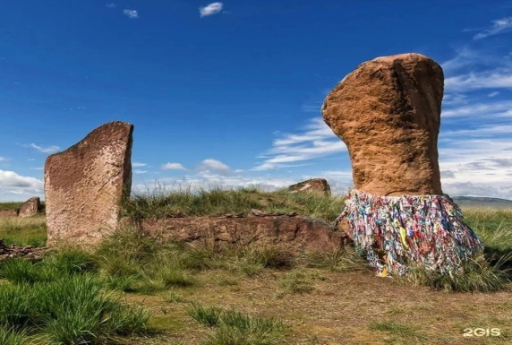
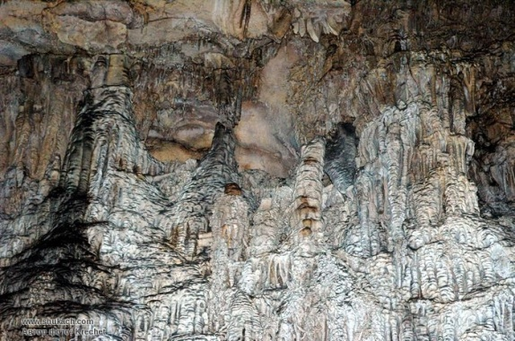
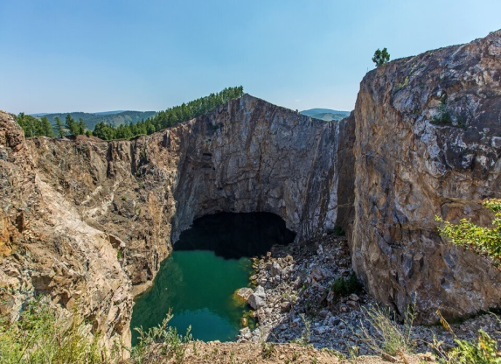
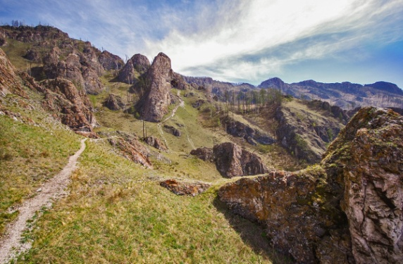
Mysteries of Khakassia
(3 module)
Day 10
SSHHPP
Sayanogorsk - the city of hydro construction workers
Sayano-Shushenskaya HPP
Sayan Sea
Day 11
Ancient Khakassia
Abakan - the capital of Khakassia
Salbyk barrow
Borodinskaya cave
Salt lakes of Khakassia
Day 12
Lakes of Khakassia
Lakes of Khakassia
Tuimsky failure
Trail of ancestors
Shira

Slide 8
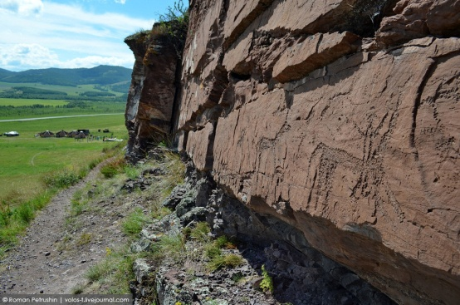
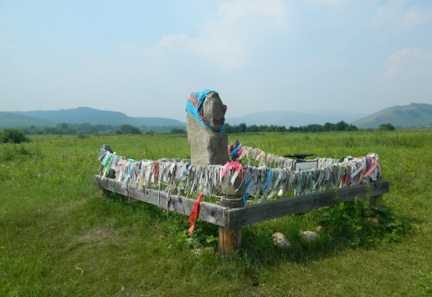
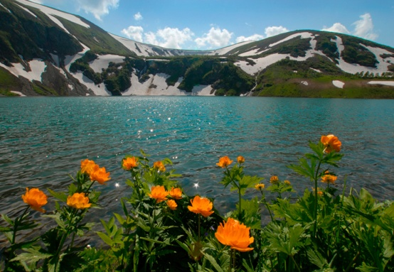
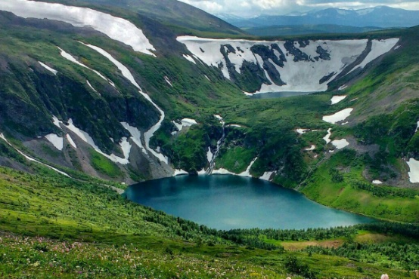
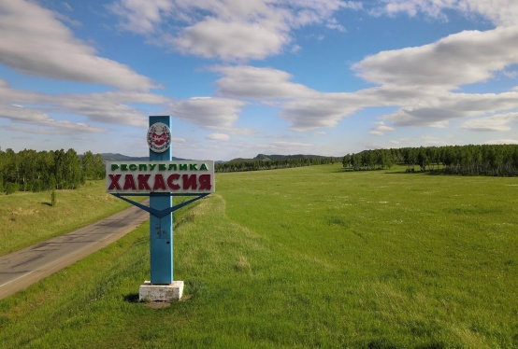
Mysteries of Khakassia
(3 module)
Day 13
Ivanovskie lakes
Sulek Pisanitsa (ancient rock paintings)
Saralinsk stone maiden (monument of the "Okunev" culture)
Ivanovskie lakes
Day 14
Farewell to Khakassia
Ordzhonikidze
Abakan / Krasnoyarsk

Slide 9
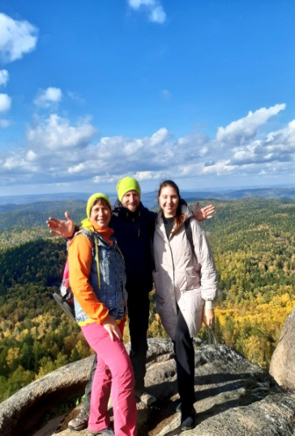
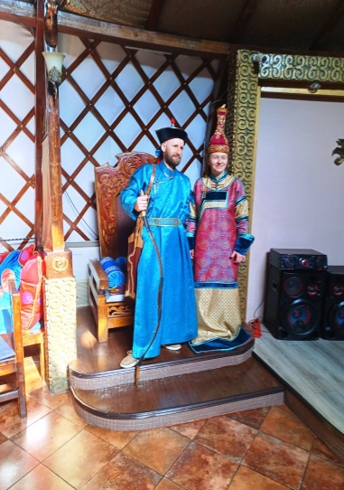
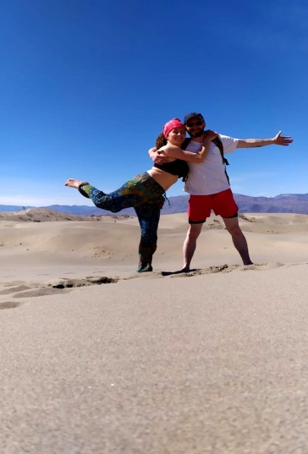
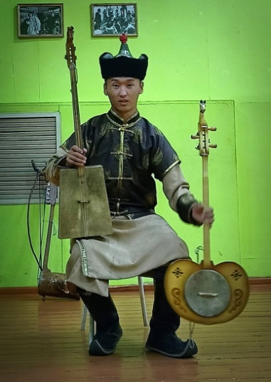
What's included in the tour:
transfer
accommodation
meals
*partly on your own
gift souvenir
museum entrance tickets
excursions/guide
accident insurance

Slide 10
Tour price for organised groups
«Krasnoyarskoye Zamanye»
Number of people. | 1-2 people. | 5 people. | 10 and more people.
Cost | 53200,00 | 42500,00 | 30500,00
«Pearls of Tyva»
Number of people. | 1-2 people. | 5 people. | 10 and more people.
Cost | 130200,00 | 60500,00 | 43000,00
«Mysteries of Khakassia»
Number of people. | 1-2 people. | 5 people. | 10 and more people.
Cost | 54000,00 | 62500,00 | 52000,00
All 3 modules | 171500,00 | 164600,00 | 124500,00
** for individual tours all information by phone +7-902-923-32-33

Slide 11
Tour information
«Krasnoyarsk Zamanye» (module № 1)
Duration : 3 days/2 nights Seasonality : May-September Age restrictions : 18+ Tour difficulty : no restrictions
«Pearls of Tyva» (module № 2)
Duration : 6 days/5 nights Seasonality : May-September Age restrictions : 18+ Strictness of tour : no restrictions
«Mysteries of Khakassia» (module № 3)
Duration : 5 days/4 nights Seasonality : May-September Age restrictions : 18+ Strictness of the tour : no restrictions
The whole programme is 14 days/13 nights
You can join any of the programme modules separately OR buy the whole tour

Slide 12
Tour dates
Module 1 «Krasnoyarskoye Zamanye»
9-11 June 27-29 July 7-09 September
Module 2 «Pearls of Tyva»
30 April - 05 May 12 - 17 June 3 - 13 July - expedition "Mountains of Tyva and Mongolia" (programme under development) 30 July - 4 August 10-15 September
Module 3 «Mysteries of Khakassia»
18-22 June 5-9 August 16-20 September
If you would like to purchase a tour on other dates, please contact the manager

Slide 13
Official Site: https://заманье-тур.рф/
Email: zamanie_tur@mail.ru
Phone number.: +7-391-2-933-233,
WhatsApp, Telegram, Viber: +7-902-923-32-33

